Slide 1
PROJECT ON ANALYSIS OF SHAPER MECHANISM
Group-3
Anjeet Kumar- 234103407
Digvijay Kumar-234103415
Sanjay Kumar- 234103434

Slide 2

Introduction
A Shaper mechanism is a robust machine used to remove material from work pieces to achieve flat and smooth surfaces with high precision.
Mechanism: Quick Return Mechanism

Slide 3
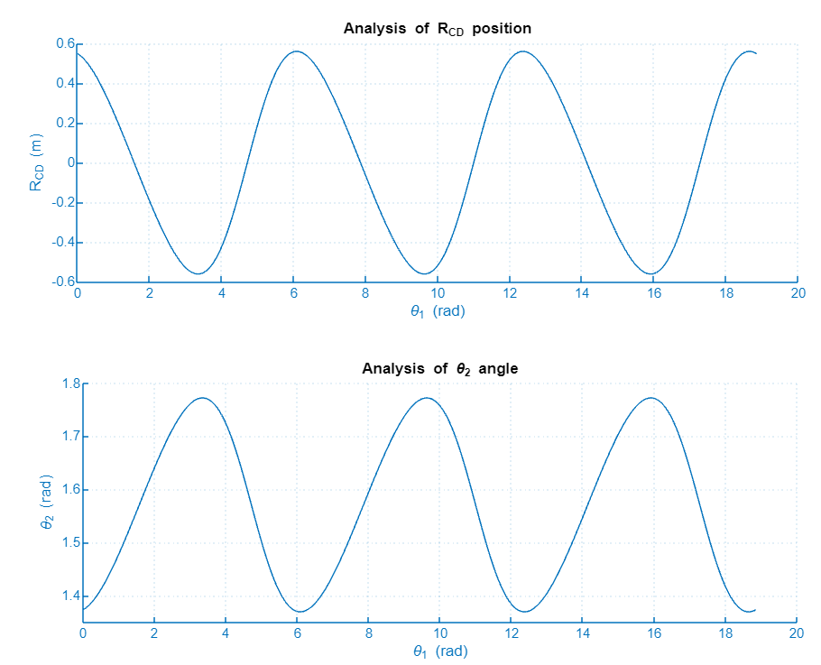
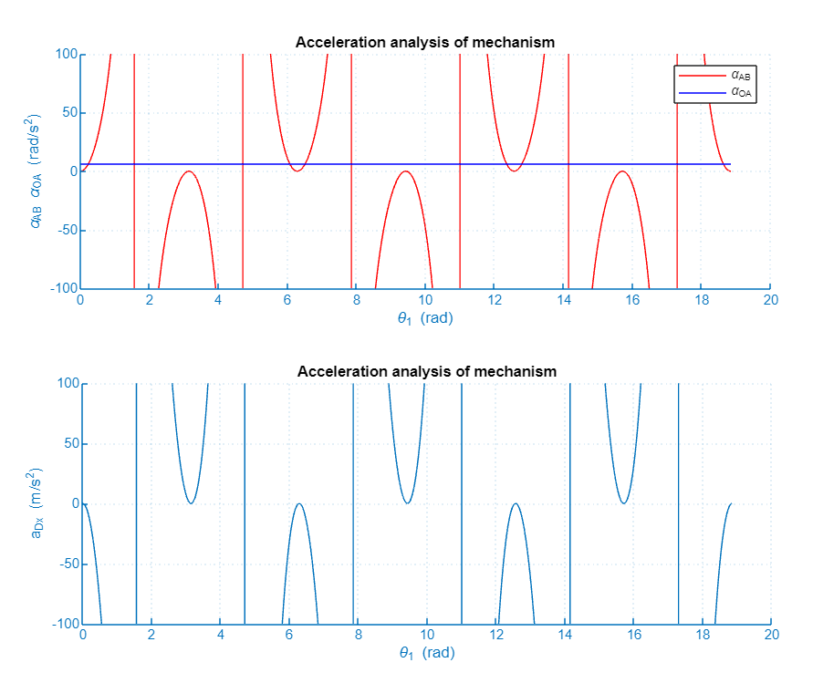

Slide 4
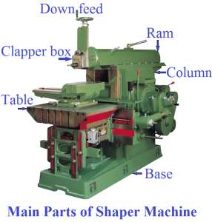
Objectives
To perform a Explicit Dynamics analysis of Shaper Mechanism
Compare the result of Total deformation, Equivalent stress ,Force
Conducting the parametric study for other cutting tool velocity.
Analyzing the result and developing the interference with different velocity
Methodology
Geometry-3D object with work pieces and Tool
Meshing
Boundary Condition : Fixed Support and Velocity for the tool
Connection Details: The body intersection is set to be frictional

Slide 5
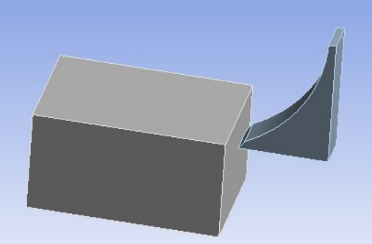
Methodology
Work pieces(AL 6061)
Tool(Titanium)

Slide 6
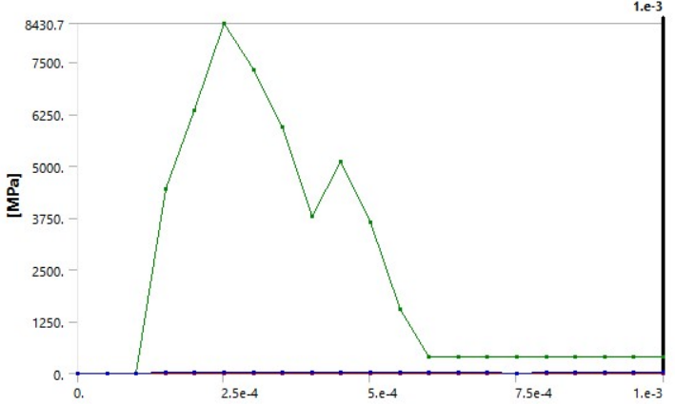
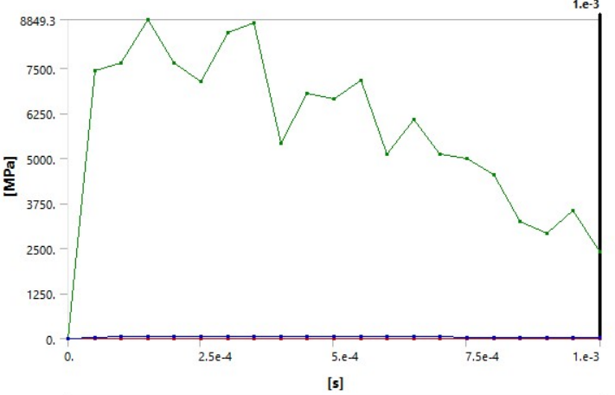
RESULTS
Velocity | Max. Total Deformation | Force
2.9e+005 mm/s | 460.14 mm | 748.33 KN
90000 mm/s | 104.28 mm | 847.80KN
Results:

Slide 7
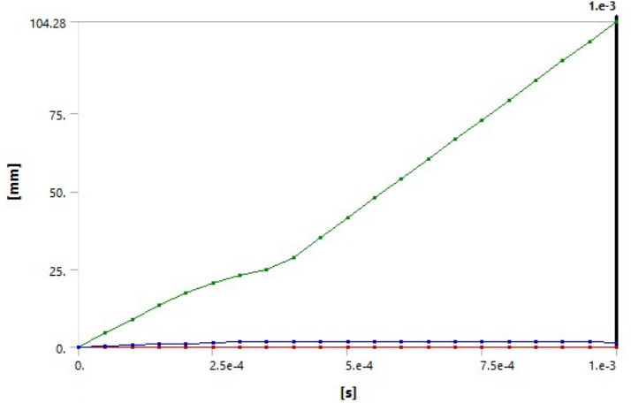
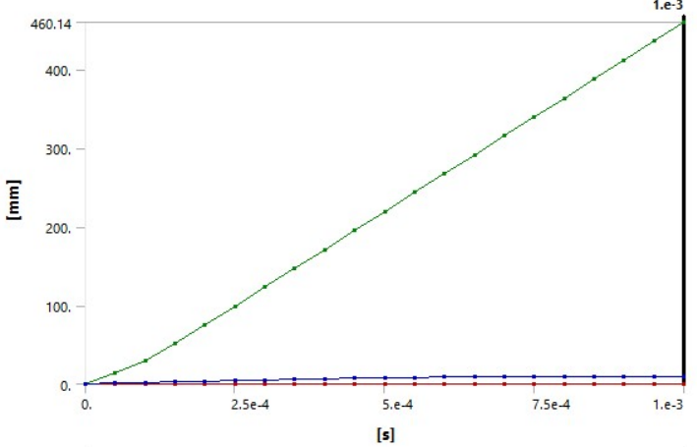

Slide 8
Conclusion
Higher the velocity of the cutting tool, lower will be stress developed.
Hence ,lower effort required for higher cutting speed.
Productivity will increase.
THANK YOU

